Slide 1
Consciousness, Sleep & Drugs

Slide 2
The Big Questions
What is consciousness?
And how can I lose it!?
Facts about dreams, drugs and other altered states..

Slide 3
What is Consciousness?
Searle: “Consciousness consists of inner, qualitative, subjective states and feelings or awareness”
Qualitativeness: “feels like something..”
Subjectivity: each person has their own, cannot be experienced outside of a being..
Unity: single unified experience at each moment: not disjointed grab-bag of uncoordinated stuff..

Slide 4
The “hard problem”
Chalmers: How does a physical system (the brain) produce this amazing thing we experience as consciousness?
In other words, can we come up with an objective understanding of subjective experience?
Vs. “easy” problems: ability of system to access its own internal states, report on them; ability to focus attention; deliberate control of behavior…

Slide 5
Click hard
I think the hard problem:
A. Means that “mind” is a non-physical substance (dualism)
B. Is an illusion: once we understand enough about the brain, it will go away (materialism)
C. Is impossible because subjectivity can never be understood objectively, by definition.

Slide 6

Descartes: Cogito Ergo Sum
I think, therefore I am
Subjective cognition is primary
Solipsism: subjective cognition is all there is!

Slide 7
What is Subjective Experience?
Is Subjective Experience easier to define than Consciousness?
What kinds of things have subjective experiences? What are the essential properties of a subjective experience?
What is the simplest thing that has some kind of subjective experience?
Does it have to be aware of the experience to have it?
If not, then perhaps EVERYTHING has subjective some kind of subjective experience?

Slide 8

The Life of a Stone
Unique 3D position, velocity, trajectory, temperature, wet / dry, etc etc..
Only thing missing is awareness of these things
But that’s the *easy* problem!

Slide 9
My Perspective
1. Consciousness is just another name for what it’s subjectively like to “live” inside a human brain
Because we are human, consciousness = human
NOTHING else has human consciousness, by definition.
BUT, animals share many brain features, and their subjective experience is likely to be similar in many ways.. But never the same. And we’ll never know, because they are *locked in*
And btw, I don’t even know about you..

Slide 10
My Perspective
2. The “hard” problem is impossible (and silly)!
Objective science will never penetrate the subjective world of the mind
This does not imply dualism or that consciousness is not also material (again, think of the rock..)
It is just two fundamentally separate perspectives on the same thing: subjective (inside-out) vs. objective (outside-in) – nothing “magic” except that our brains give us a really great subjective life..

Slide 11
Consciousness Science
Forget about all the philosophical mumbo-jumbo, and just do objective science on consciousness phenomenology:
When are people conscious, not, or altered?
What features / states of brain associated with different states of consciousness?
What features of subjective consciousness associate with different features of brain?
NCC: Neural Correlates of Concsciousness

Slide 12
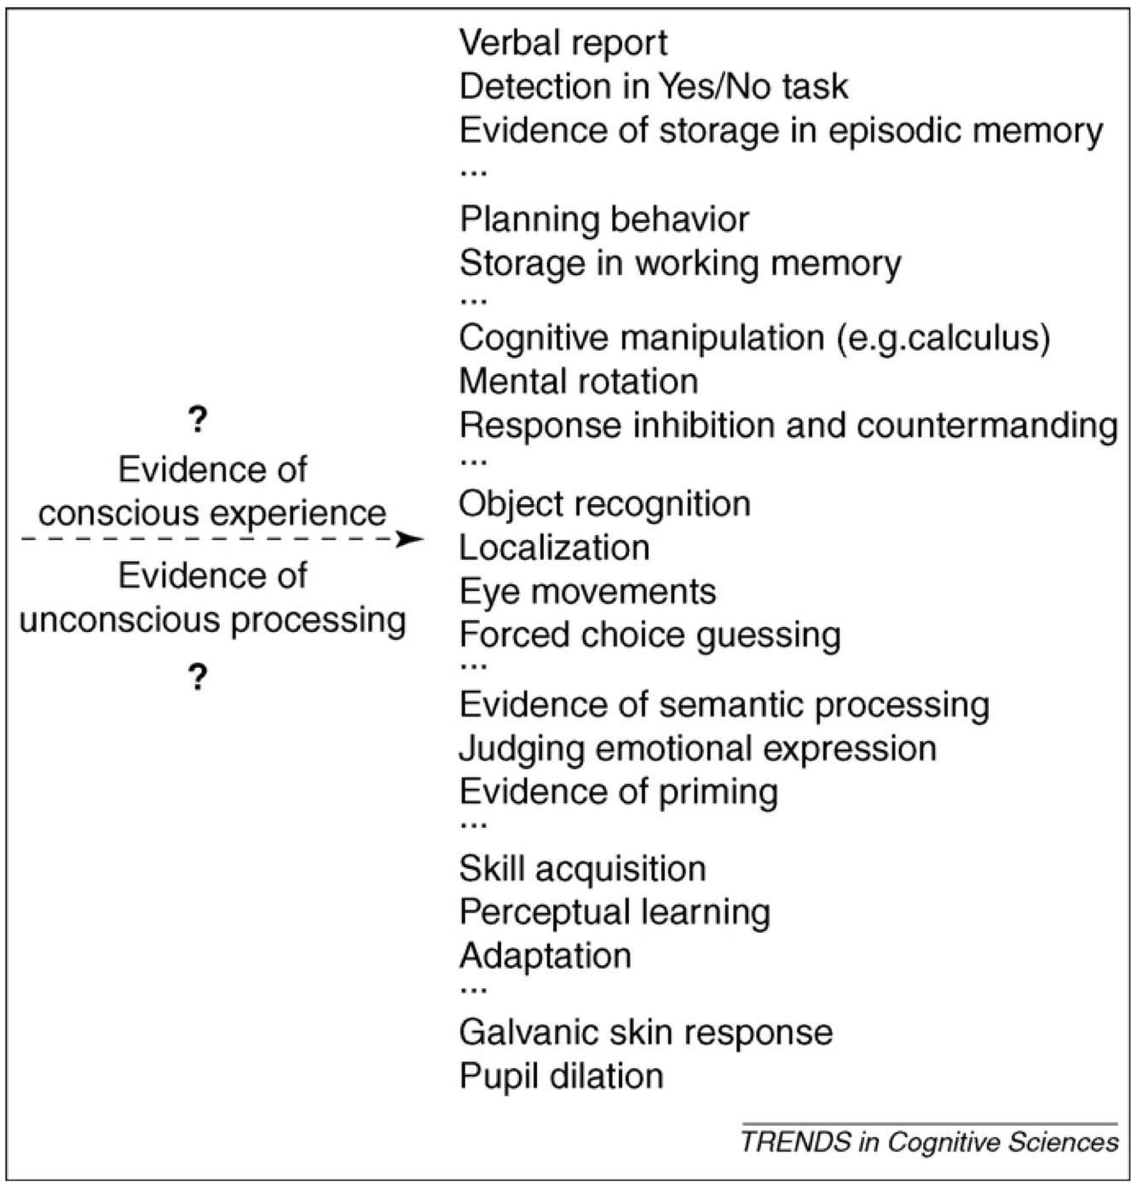
What Counts as Conscious?

Slide 13
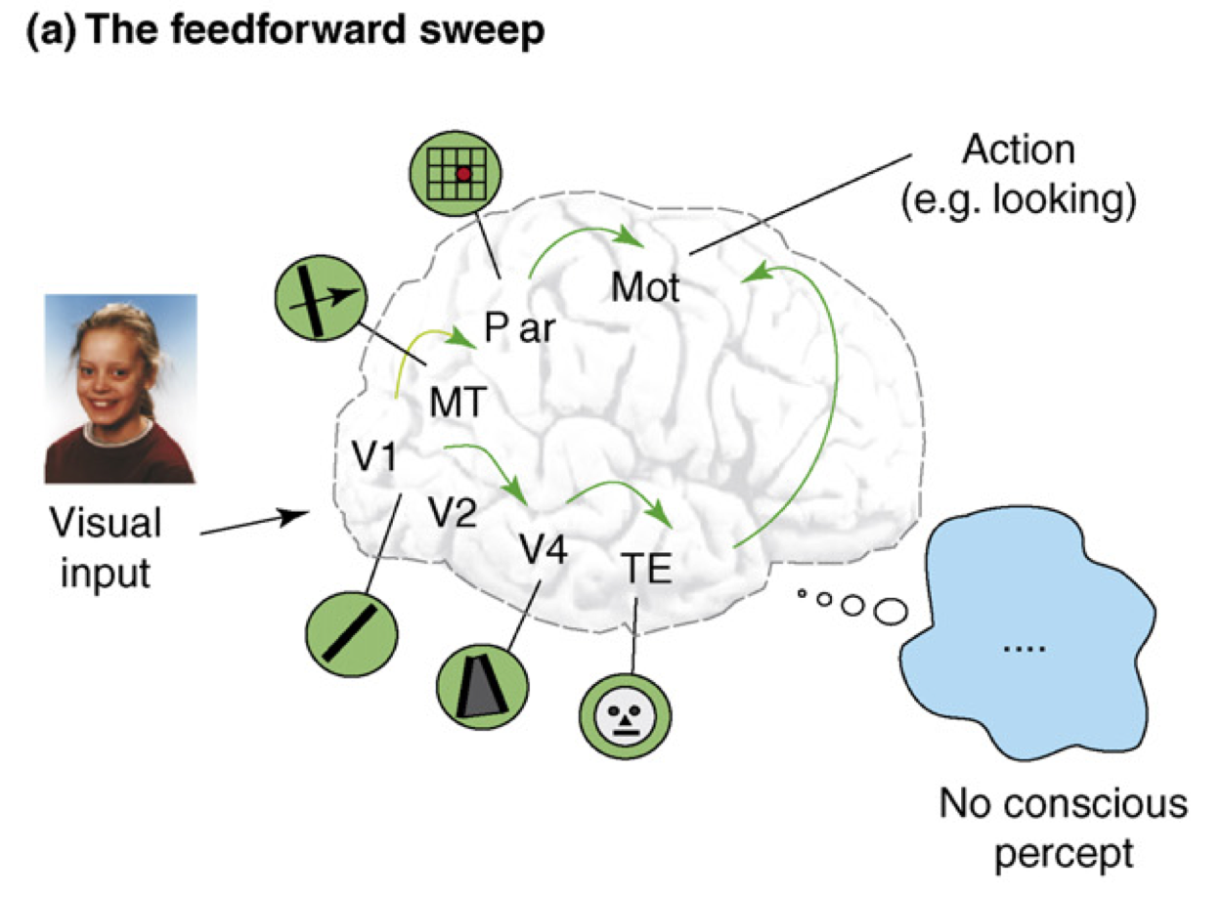
Recurrent Processing = Consciousness (Lamme, 2006)

Slide 14
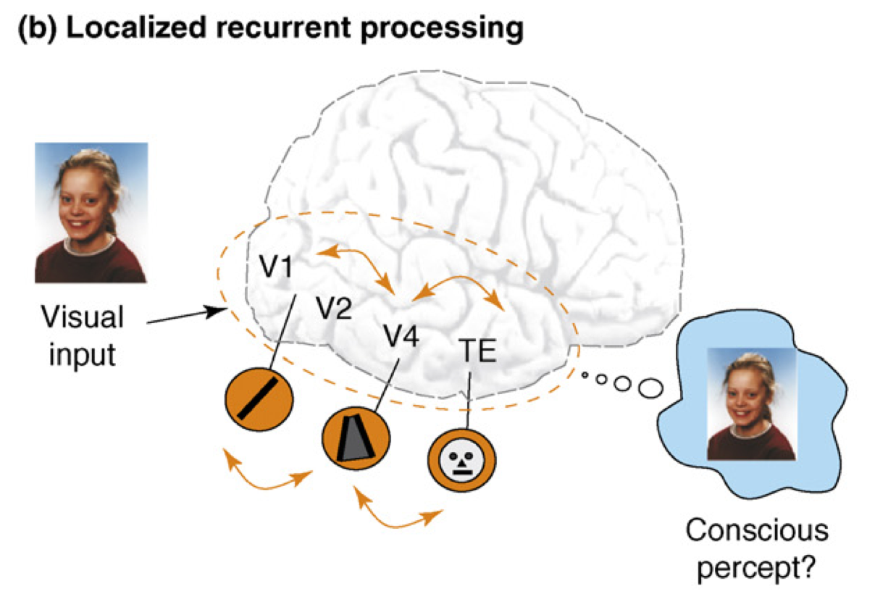
Recurrent Processing = Consciousness (Lamme, 2006)

Slide 15
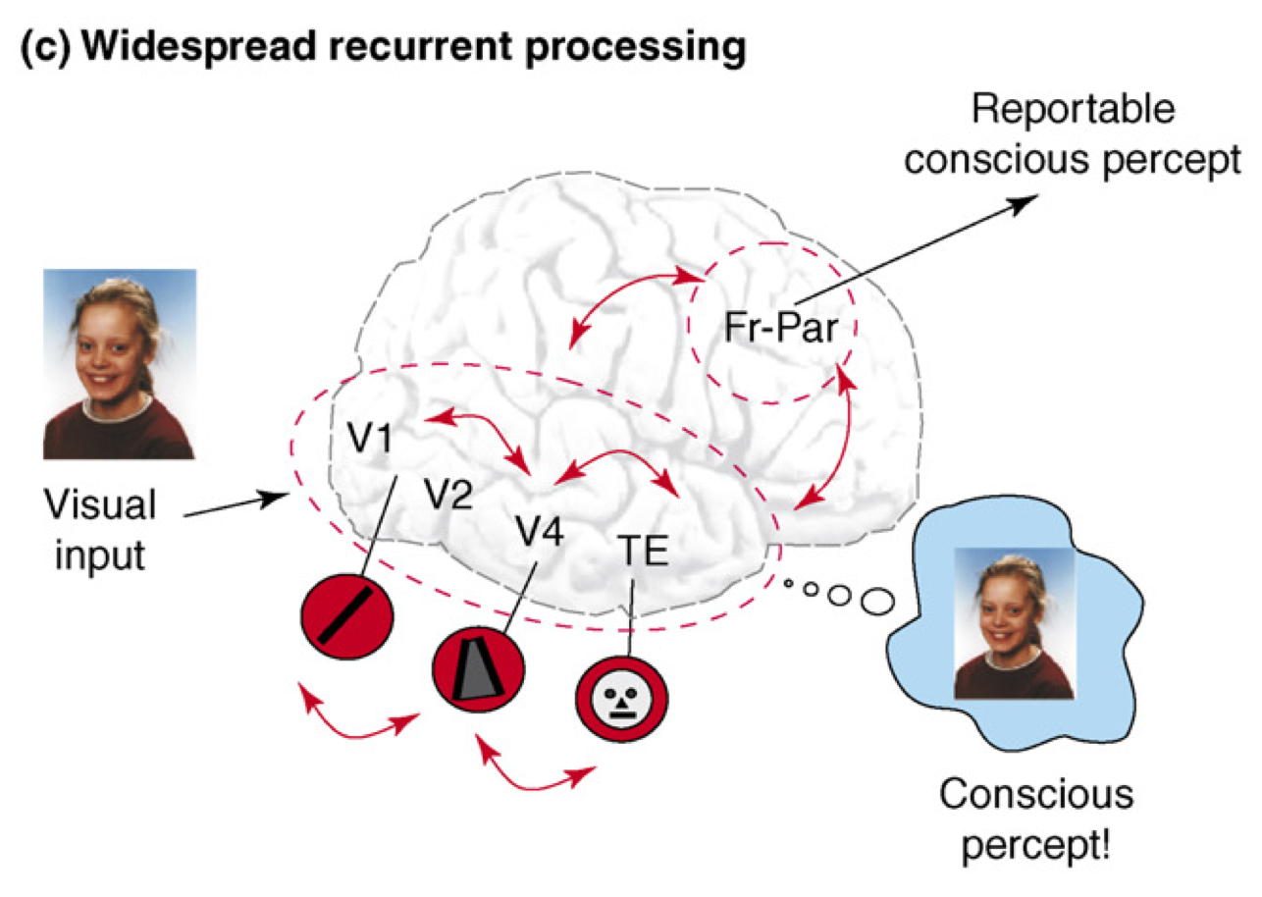
Recurrent Processing = Consciousness (Lamme, 2006)

Slide 16
Recurrence == Consciousness
Consciousness is Unitary
Recurrence coordinates all areas on one thing
(That thing emerges through popular vote)
Consciousness is Functional
We learn more about conscious things
It helps us organize, prioritize our behavior
“Focusing” is necessary for difficult problems

Slide 17
Is the Pulvinar the Silver Screen of the Cartesian Theater??
We have a compelling feeling that our conscious selves are watching a movie – pulvinar is kind of a movie screen where all of our predictions are projected, at V1 resolution.. hmm..
Global workspace? Brain synchronizer?

Slide 18
Is Twitter Conscious?
A. Yes
B. No

Slide 19
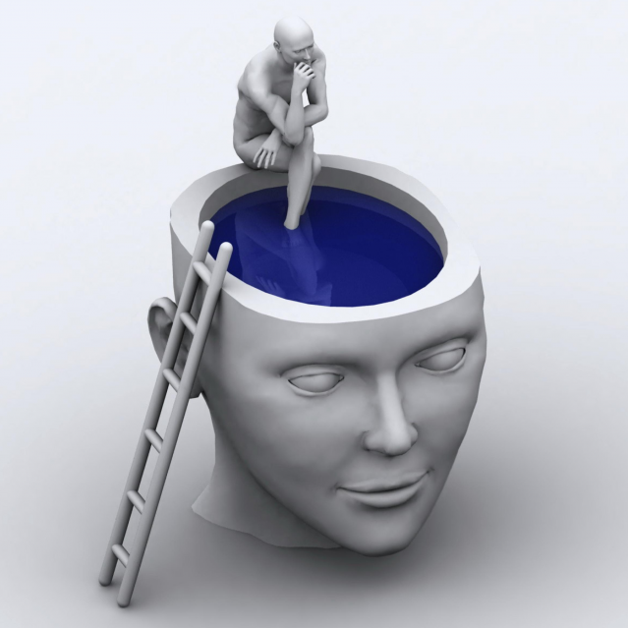
Metacognition
Awareness of awareness is also a key ingredient of human consciousness – likely associated with prefrontal cortex and other high-level brain areas.
Are you conscious when you’re not “mindful”?

Slide 20
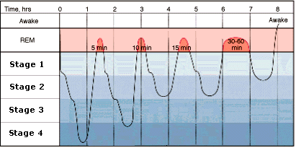
Sleep and Dreaming
Deeper = slower frequency brain waves (Theta -> Delta)
REM & Awake = Beta, Alpha, Theta

Slide 21
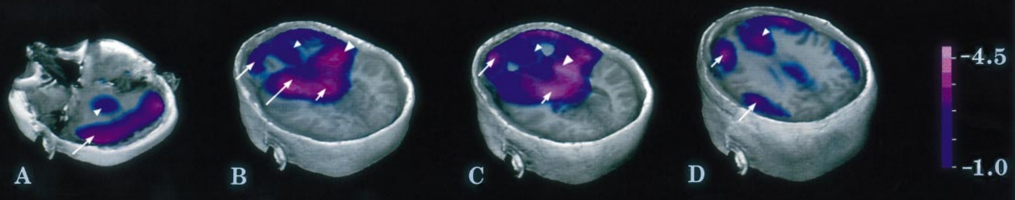
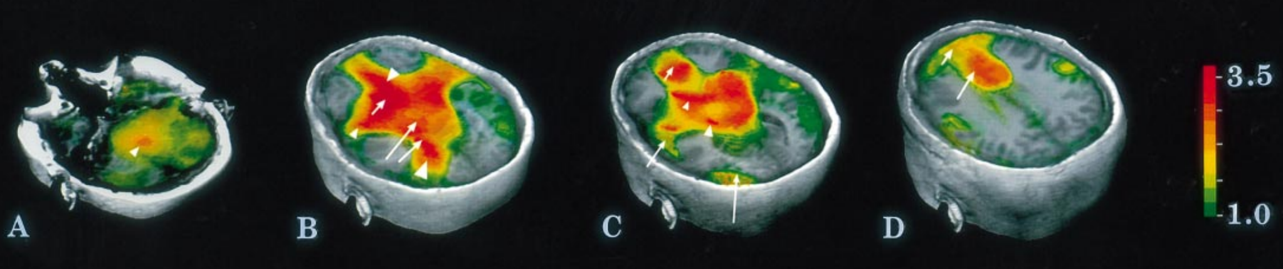
Your PFC Goes to Sleep
And your limbic system wakes up!
Dreams are disorganized, inconsistent over time
And very emotionally charged: lots of fear and lust..
Braun et al, 1997: http://brain.oxfordjournals.org/content/brain/120/7/1173.full.pdf

Slide 22
Why do we sleep?
Synthesize proteins in synapses, etc:
Use your brain during the day, (re)build your brain at night
Why babies sleep so much..
Result = better memory after sleep – “consolidated” synapses

Slide 23
Which disorder have you had!?
A. Nightmares
B. Insomnia
C. Night terrors
D. Sleepwalking
E. Rem-sleep behavior disorder (RBD)

Slide 24
Altering Consciousness via Drugs
Do all drugs alter consciousness?
Are drugs actually addictive?

Slide 25
Addiction -> Dependence Terms
Withdrawal: unpleasant feelings from lack of use
Craving: overpowering feeling of wanting
Tolerance: progressive need for more to get same effect

Slide 26
Neuromodulators and Drugs (receptor agonists)
Acetylcholine (ACh): muscles, attention, learning, memory (nicotine)
Dopamine (DA): when to learn, based on reward prediction errors (cocaine)
Norephinephrine (NE): attention, engagement (speed)
Serotonin (5HT): Mood, sleep, appetite, sex, stress (SSRI, LSD = waking dream)
Oxytocin: social modulation, labor (pitocin)
Endorphins, Substance P: pain (heroin)
GABA: inhibition (benzo, valium, etc)

Slide 27
Drugs (receptor agonists)
Narcotics: Opium derivatives (heroin, morphine..): opioid receptor agonists
Depressants: Benzo, Valium: GABA inhibition agonists
Stimulants: nicotine (ACh receptor agonist), cocaine (Dopamine receptor agonist), amphetamine (Norepinephrine + receptor agonist), caffeine (Adenosine antagonist -> Dopamine agonist)
Psychedelics: LSD, peyote, mescaline, psilocybin: affect serotonin; Marijuana: cannabanoid receptors

Slide 28
What have you tried? A = yes, B = no
Alcohol
Nicotine
Marijuana
Cocaine
Psilocybin (shrooms)
LSD
Heroin

Slide 29
Are you dependent on any drugs?
A. Yes
B. No

Slide 30
Mouse Party!
http://learn.genetics.utah.edu/content/addiction/mouse/

Slide 31
Hypnosis
Bottom line: people are lemmings!

